Slide 1
About The Society of Creation
June 12, 2026, 5:00 p.m.

Slide 2
Agenda overview
Opening Song
Welcome and Opening Prayer
Some History
Membership & Charter
Plans for the Future
Our Finances
Recognitions
Closing Prayer
Notes:
Great to be back at our former congregation. Restrooms are …. Although Lutherans and other Protestants don’t believe in purgatory, driving through Chicago traffic felt a bit like purgatory. But at least we didn’t feel like a man who had a really bad day ….

Slide 3

origins
Founded by Dr. Gary Locklair, Computer Science, and Dr. Joel Heck, Theology, in 2011, out of concern for …
First creation conference at Concordia University Wisconsin in 2013.
This year’s conference is the twelfth annual, although a two-year hiatus (2024 and 2025) just finished.
Membership of about 460 (no membership fee)

Slide 4

Our Website
www.societyofcreation.org

Slide 5
History of Conferences
Our intent was to rotate between the following four themes:
    The Origin of Diverse Kinds of Life
    Human Origins
    The Origin of the Universe
    The Origin of Life

Slide 6
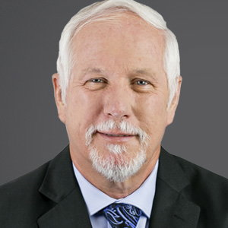
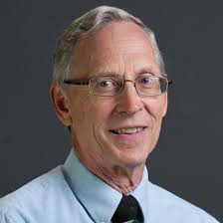
Conferences, 2013-2015
The first creation conference was held on July 8-10, 2013, at Concordia University Wisconsin.
Theme: “The Heavens Declare: What Astronomy Can Tell us about Biblical Creation.”
Keynote speakers: Dr. Danny Faulkner and Dr. Don DeYoung.

Slide 7
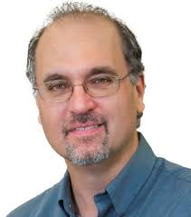
Conferences, 2013-2015
The second annual conference was held on June 30 to July 2, 2014, at Concordia University Wisconsin. Theme: "The Origin of Life: The Improbability of Chance, Mutation and Natural Selection.“ Keynote speakers: Dr. Kevin Anderson and Jay Seegert, the Creation Education Center in Waukesha, Wisconsin.

Slide 8
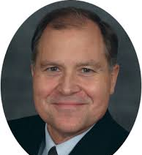
Conferences, 2013-2015
The third annual conference took place on July 6-8, 2015, at Concordia University Ann Arbor, located in Ann Arbor, Michigan, under the theme, “The Origin of Diverse Kinds of Life: Dinosaurs.” Keynote speakers included Dr. Kevin Anderson and Dr. Timothy Clarey.

Slide 9
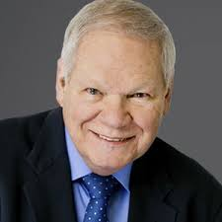
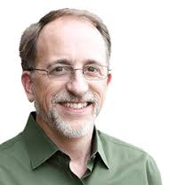
Conferences, 2016-2018
The fourth annual conference occurred on June 10-11, 2016, at Concordia University, St. Paul, Minnesota. Theme: “Adam and Eve: Myth or Reality?” Keynote speakers: Dr. Rob Carter, CMI, and Dr. David Menton.

Slide 10
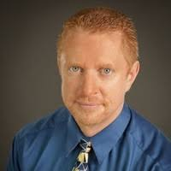
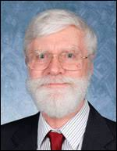
Conferences, 2016-2018
The fifth annual conference was held on July 7-8, 2017, at Concordia University Wisconsin. Theme: “The Age of the Earth.” Keynote speakers: Dr. Don DeYoung, Jay Seegert, and Dr. Russell Humphreys.

Slide 11
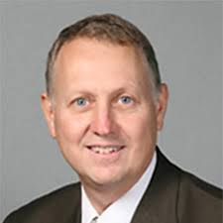
Conferences, 2016-2018
The sixth annual conference was held on June 29-30, 2018, at Concordia University Wisconsin. Theme: “Theistic Evolution—A Contentious Compromise.” Keynote speakers, Dr. Gary Locklair, Dr. Andrew Steinmann (Concordia University-Chicago), and Dr. Joel Heck.

Slide 12
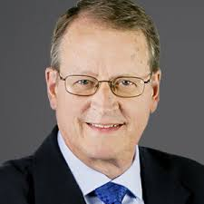
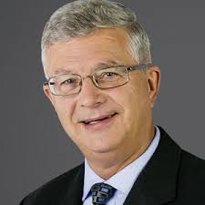
Conferences, 2019-2021
The seventh annual conference took place on June 14-15, 2019, at the International Center of the LCMS in St. Louis, Missouri.
Theme: “Thousands not Billions: How Old is the Earth?” Keynote speakers: Dr. Andrew Snelling, & Dr. Terry Mortenson, AIG. Our website has 28 YouTube videos from 2019 through 2022 & several audio files under the Archives tab.

Slide 13
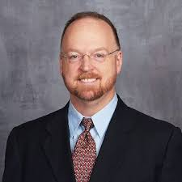
Conferences, 2019-2021
The eighth annual conference was online, June 6, 2020, Theme: “Origin of the Universe.” Keynote speakers: Spike Psarris and Dr. Russell Humphreys. Our highest attendance at ca. 450.

Slide 14
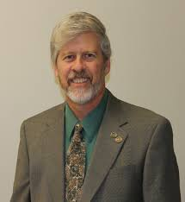
Conferences, 2019-2021
The ninth annual conference on June 5, 2021, by Zoom. Theme: “The Origin of Life.” Guest speakers included Dr. Gary Locklair, Dr. Joel Heck, and Dr. Kevin Anderson.

Slide 15
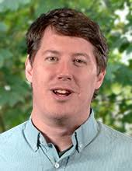
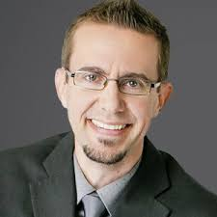
Conferences, 2022-2026
The tenth annual conference at Concordia University Wisconsin on June 24-25, 2022. Keynote speakers: Dr. Matthew Cserhati and Dr. Nathaniel Jeanson. Theme: “The Origin of Diverse Kinds of Life.”

Slide 16
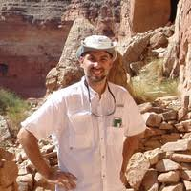
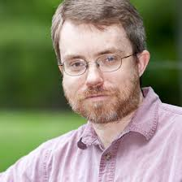
Conferences, 2022-2026
The eleventh annual Creation Conference took place at Concordia University Wisconsin on June 16-17, 2023. Theme: “The Creation of Human Beings.” Keynote speakers were nationally known scientists Dr. Marcus Ross and Dr. Todd Wood.

Slide 17
Conferences, 2022-2026
After a two-year gap, we now are hosting the twelfth annual Creation Conference.
Theme: Creation of Human Beings
June 12-13, 2026
St. Paul Lutheran Church, Grafton, Wisconsin
28 conference videos from past conferences between 2019 and 2022.

Slide 18
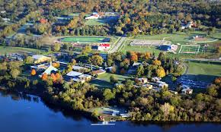
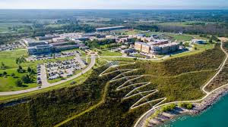
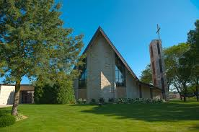
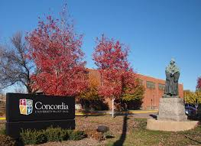
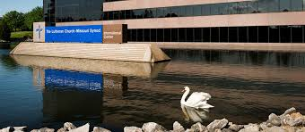

Slide 19
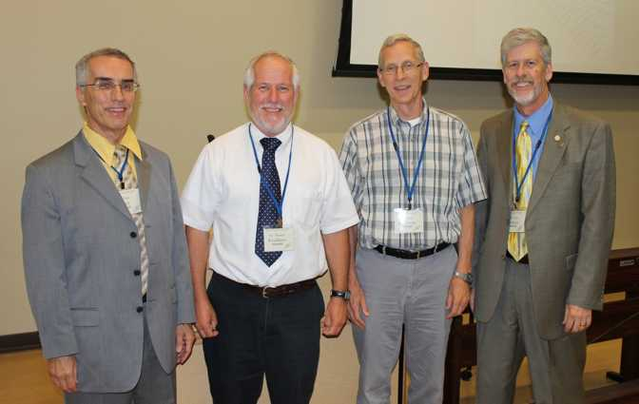
Agenda
Opening Prayer
History
Membership & Charter
Plans for the Future
  2027 Conference Location and Theme
  Publicity Plan
  Our website: www.SocietyofCreation.org
  Your role in the next year, including your evaluations
Our Finances
Recognitions
Closing Prayer
2013: “The Heavens Declare”
Joel Heck, Danny Faulkner, Don DeYoung, Gary Locklair

Slide 20
Membership & charter
Our Charter
We support the historic position of The Lutheran Church—Missouri Synod on creation. Our charter states, "To provide support, education, affirmation, and encouragement for those who teach the historic position of the LCMS on the doctrine of creation and to affirm the biblical position on creation." We do not take positions on other issues, relevant though they may be.
Membership: This is a voluntary organization that started with full-time members of the faculties of Concordia University System (CUS) institutions of higher education…

Slide 21
Membership & charter
… It then broadened to include people of all walks of life, all denominations, all occupations, and all levels of interest. The Denver Society of Creation is affiliated with the Society of Creation.
Purposes: To provide support, education, affirmation, and encouragement for those who teach the historic position of the LCMS on the doctrine of creation and to affirm the biblical position on creation. Likewise, it supports all Christians everywhere who believe the biblical narrative of Genesis 1 and 2 as it is presented.

Slide 22
Membership & charter
Dues: None. Some programs and projects, as agreed upon in advance by the members, may be funded by contributions of members, all of them sharing equally in the cost and that cost known in advance. Those who are unable to contribute may give their blessing but decline to share in the cost.
Programs and Projects: Major programs and projects will normally be carried out with the approval of a minimum of eighty percent (80%) of the votes cast by the membership in advance with email votes being recorded by the initiator, who can be any member of the organization. Programs are for the mutual encouragement and support of its membership.

Slide 23
Membership & charter
We held our first conference in the summer of 2013, at which members may present papers that include their biblical or scientific understanding and insight into creation. We have since held an annual creation conference each summer.
Publicity: We especially depend upon email addresses of members, word of mouth, our Facebook page, and the website of the Society of Creation.

Slide 24
Membership & charter
Biblical Subscription: In accordance with LCMS convention resolution 2004 Res. 2-08A, Luther's Small Catechism with Explanation, Question 97 [CPH, 1986, p. 106], and A Brief Statement (Adopted 1932, St. Louis: Concordia Publishing House), all members subscribe to the following statement of their position on creation:
First, that God created by His power, as described in Genesis 1 and 2, motivated by His love and grace, rather than using evolution as the vehicle of creation.
Second, that God created mankind in His image, giving them the ability to respond to Him in worship and service. As a result, mankind has authority to subdue the earth, which is neither a license to destroy or pollute nor a prohibition against any changing of the landscape. This authority has been affected by the fall into sin (Genesis 3).

Slide 25
Membership & charter
Third, that each member of the Trinity was involved in creation, as indicated in Gen. 1:1-3.
Fourth, that creation took place in six twenty-four-hour days with a day reckoned in accordance with today’s time.
Fifth, that Adam and Eve were real, historical human beings and that the fall into sin was a real, historical event.
Sixth, that creation occurred in the relatively recent past, thousands of years ago rather than millions or billions of years ago.

Slide 26
Life on the Silent Planet
Edited by Rhys Laverty
Essays on each volume in the Ransom Trilogy by well-known Lewis scholars, in turn dealing with masculinity, femininity, and marriage
Part I: Out of the Silent Planet
Part II: Perelandra
Part III: That Hideous Strength

Slide 27

Colin Smothers
Colin Smothers, “Men are from Mars: Masculinity in Out of the Silent Planet”

Slide 28
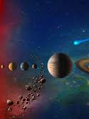
“Men Are From Mars”
“Lewis chose the planetary settings of Mars, and subsequently Venus and Earth, to remind the world of fundamental—even forgotten—truths about human nature, masculinity, femininity, and marriage which he saw eroding in the early 1940s.”

Slide 29
“Men Are From Mars”
For masculinity, the various authors spoke of leadership, responsibility, and courage as central characteristics of masculinity, exemplified by the characters of the three science fiction stories.

Slide 30
Finances

Slide 31

recognitions
Dr. Gary Locklair, CUW and CRS
Dr. Randy Ferguson, CUW and St. Paul Lutheran Church
Dr. Timothy Clarey, ICR
Dr. Angus Menuge, CUW
Dr. Michael Young, CUW
Dr. Jeff Tomkins, ICR
Mr. Joshua Nelson, WLHS

Slide 32
recognitions
The pastors and staff of St. Paul Lutheran Church, especially Pastor Luke Anderson and Pastor Timothy Maschke
IT Support
Keynote Speakers + CRS and ICR
Cheryl Heck
Participants, including your many comments and encouragements
Closing/Opening Prayer

